Slide 1
CSS
Usefull to know

Slide 2
RESET-CSS

Slide 3
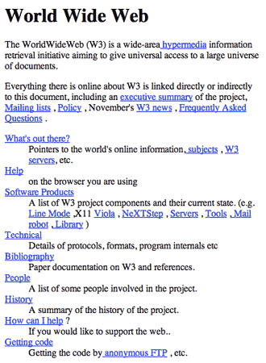
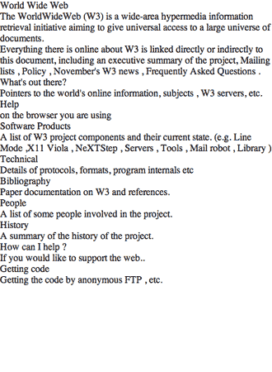
RESET?

Slide 4
Rounded corners

Slide 5
Multiple
border-radius: 20px;

Slide 6
border-radius
border-radius: 6px 12px 18px 24px;
border-top-left-radius: 6px;
border-top-right-radius: 12px;
border-bottom-left-radius: 18px;
border-bottom-right-radius: 24px;

Slide 7
Ellipses
border-radius: 50px/100px; border-bottom-left-radius: 50px;
border-bottom-right-radius: 50px;
100px
50px

Slide 8
Background

Slide 9

Multiple
background-image: url(sheep.png), url(grassandsky.png); background-position: center bottom, left top; background-repeat: no-repeat;

Slide 10
background-size
COVER IMAGE

Slide 11

background-size: auto

Slide 12
background-size: contain

Slide 13
background-size: 100% 100%

Slide 14
background-size: COVER

Slide 15
background-position: center

Slide 16
background-position: right

Slide 17
Playtime

Slide 18


Slide 19
Px vs em

Slide 20
Px vs em
An em unit is a relative unit of measurement based on the parent element.
1em = fontsize
2em = 2 x fontzize

Slide 21
Px vs em
1em is equal to the font-size of the element in question.
So when using it with margins,
it will be equivalent to the font-size of the element
you're applying the margin too.

Slide 22
Px vs em
0.5 em
CSS
0.1 em
0.5 em

Slide 23
Px vs em
.exampleDiv{
font-size: 16px;
margin-top: 0.5em /* 8px */
margin-bottom: 0.5em /* 8px */
}

Slide 24
Px vs em
body{
font: 100%/1.5 serif; /* 16px, browser default */
} h1{
font-size: 2em; /* 32px */
} @media (min-width: 600px) { body {
font: 112.5%; /* 18px */
} h1 {
/* Do nothing! I'll automatically be 36px */
} }

Slide 25
Line-heigth

Slide 26
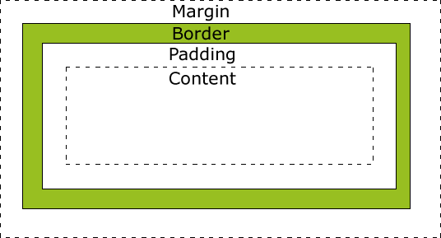
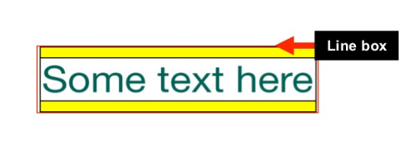

Slide 27
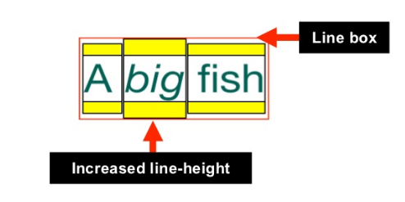

Slide 28

Notation
font-size: 30px;
line-height:60px;
font: 30px/60px;

Slide 29
Chrome
Loves you

Slide 30
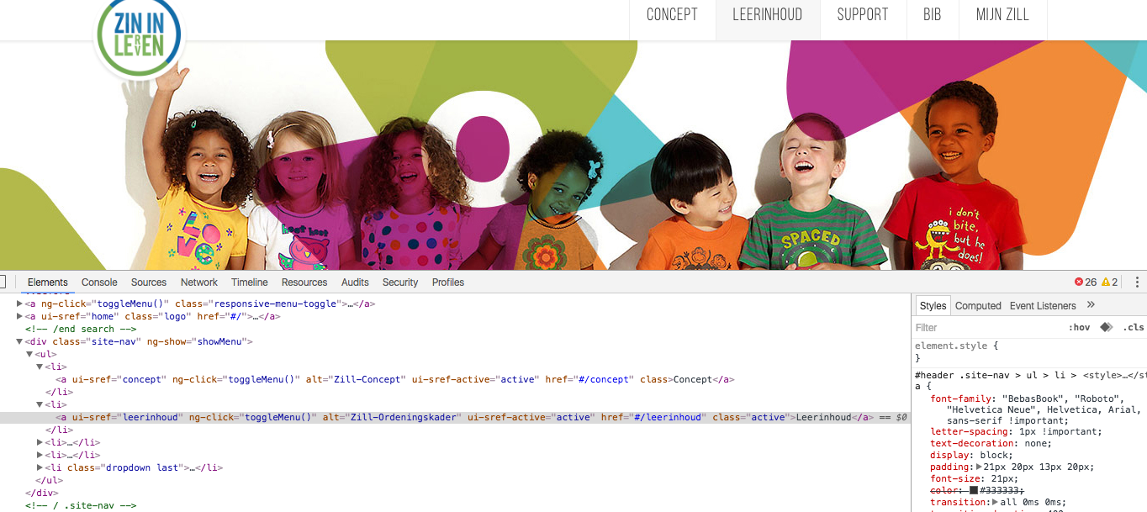
css

Slide 31
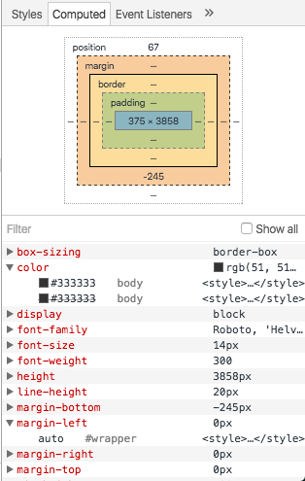

Slide 32
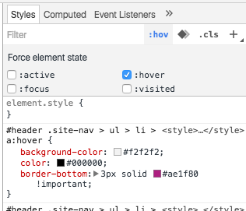

Slide 33
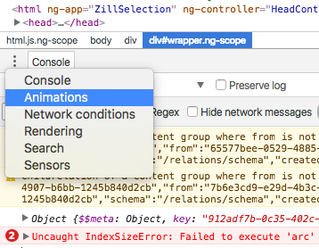
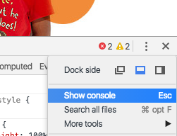
Animations

Slide 34
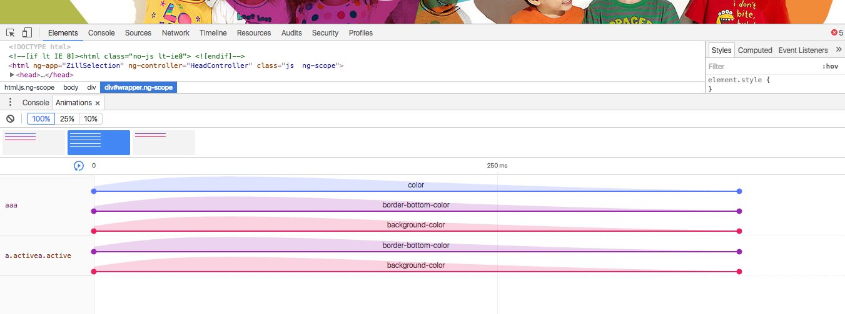
Animations

Slide 35
Workspaces
Persistent authoring in the DevTools

Slide 36
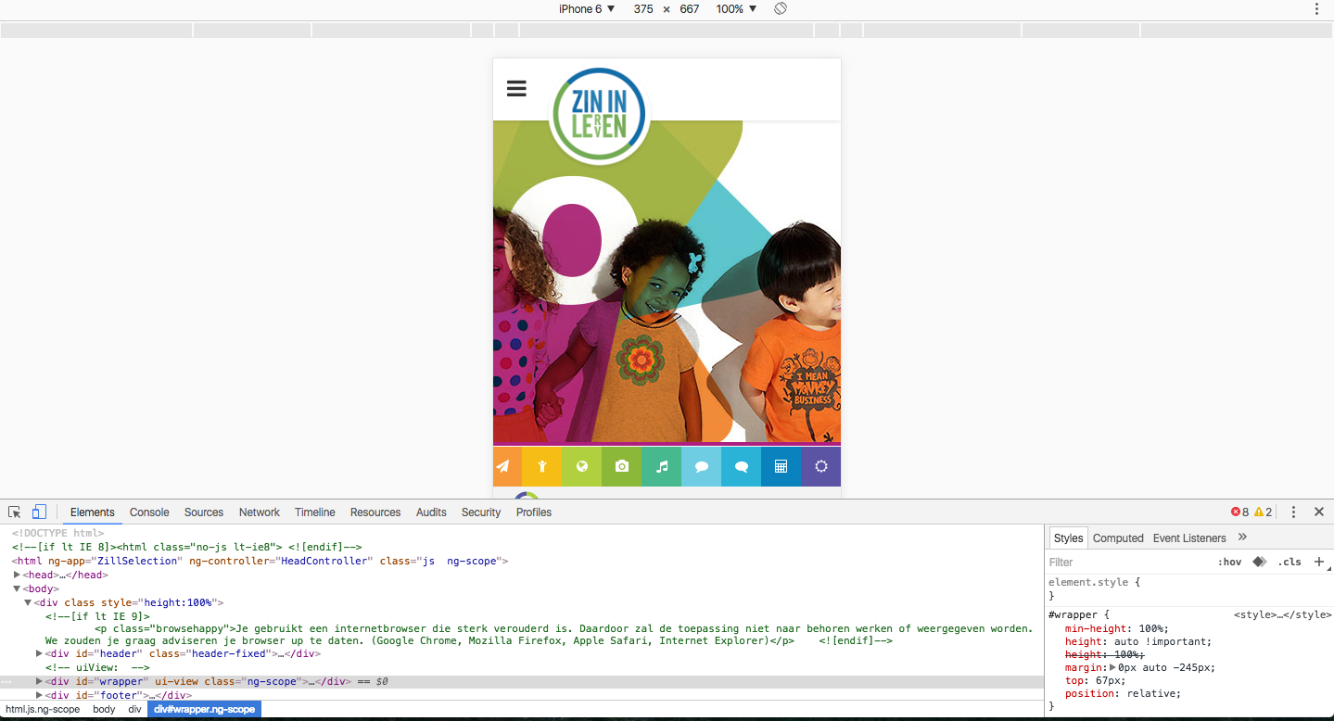
Mobile

Slide 37
Playtime

Slide 38


Slide 39
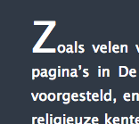

Slide 40
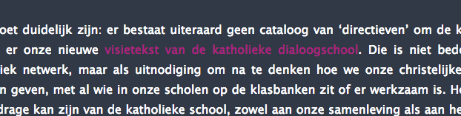
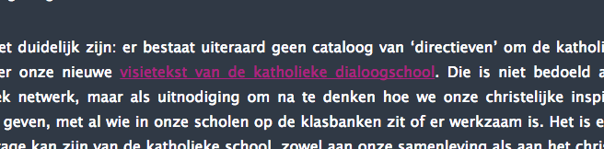

Slide 41
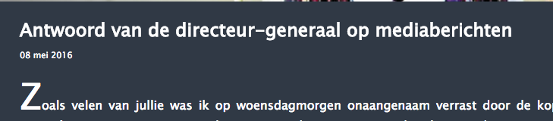

Slide 42
GITHUB
github.com/feelitloveit/cssworkshop

